Slide 1



Futurense Technologies
BUSINESS ANALYSIS
Campaign performance

Slide 2

Objectives
01
02
03
Trends Over Time
Campaingn Performance
Adset Performance
04
05
06
Best Creative_names
Platform
Conclusion

Slide 3
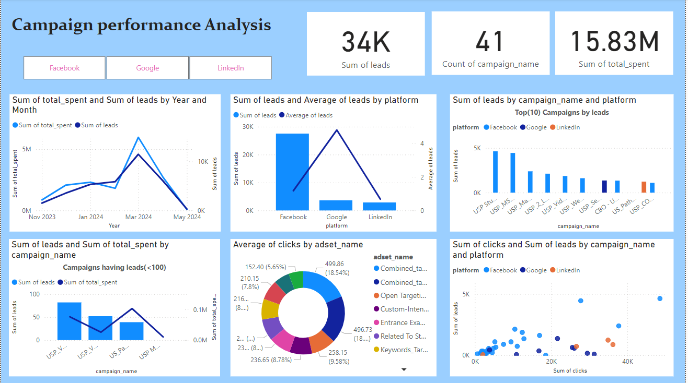
Overall Dashboard
01
02
03
04
05
06

Slide 4
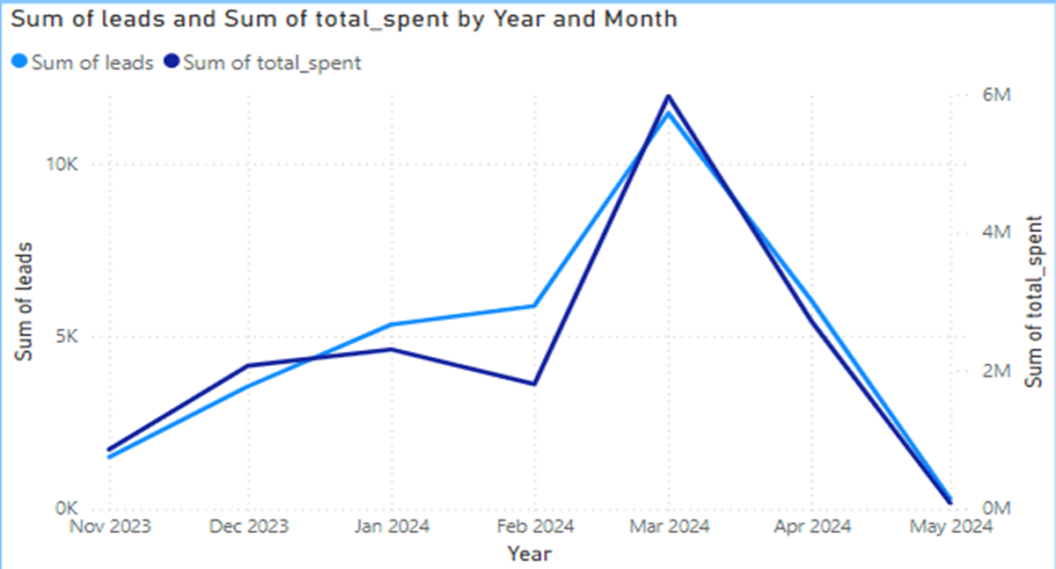


Leads Over Time
Correlation of Total spent and Leads:
The Leads incresing mostly with the increase in the total_spent.So,we can see that they are using money bravely,Yet some campaigns and ad_sets doesn’t perform good at all .Those we check further.
Most leads Genrating months:
Lorem From the above graph we can clearly see that the most leads are generated in the time period of Feb,March,April .So we should increase the campaigns and marketing before month and must focus on this time period.

Slide 5
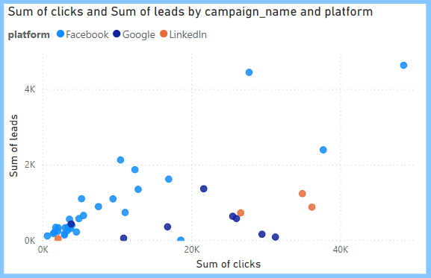
Leads increase with Clicks
Business Plan
The positive correlation between clicks and leads in the scatter chart indicates that campaigns generating more clicks tend to result in higher leads. This suggests that improving click-through rates (CTR) directly impacts lead generation, it also shows the importance of ad creatives and targeted messaging. For the business, it means focusing on high-performing campaigns with strong CTRs and replicating their strategies can drive better conversions and maximize ROI. We will again talk about it in the platform part.

Slide 6
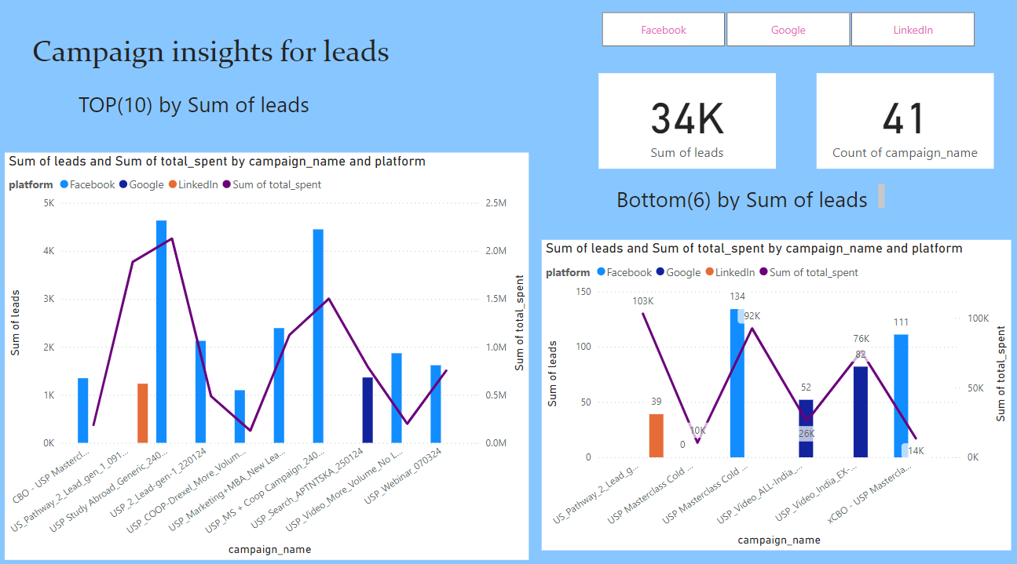
Campaign Performance
01
02
03
04
05
06

Slide 7
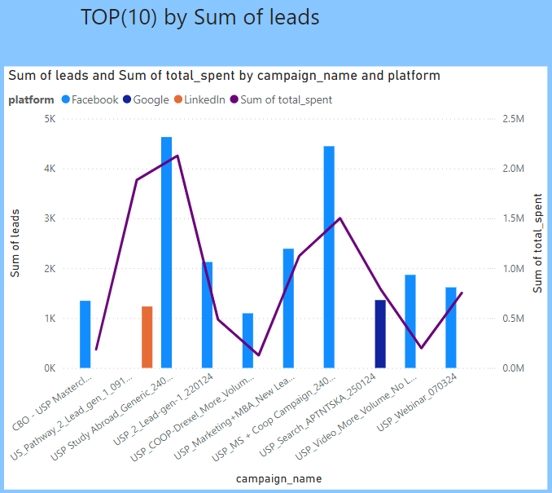
Best(10) Campaigns
Business Plan
The line-bar plot reveals the top 10 campaigns, comparing total spent (line) and leads generated (bar). A key insight is that most of these campaigns are primarily running on Facebook, with some achieving exceptionally high lead counts from those 2 campaigns shown in the figure. This highlights Facebook as a dominant platform for lead generation, So we will talk about these Facebook campaigns while analyzing their strategies to replicate success across other platforms.

Slide 8
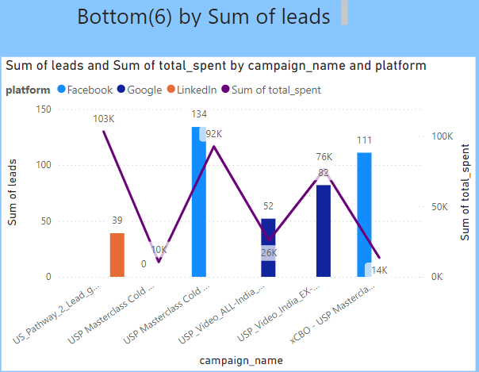
Least(10) Campaigns
Some inefficient campaigns:
The line-bar plot for the bottom 6 campaigns shows that one Facebook campaign generated 0 leads despite spending, indicating inefficiency or potential targeting issues. Additionally, some campaigns across Facebook, Google, and LinkedIn have lower lead counts, suggesting either limited audience engagement or suboptimal ad strategies. For the business, this underscores the need to reevaluate these campaigns—particularly the underperforming Facebook one—to refine targeting, messaging, or budget allocation and explore optimization opportunities on Google and LinkedIn.

Slide 9
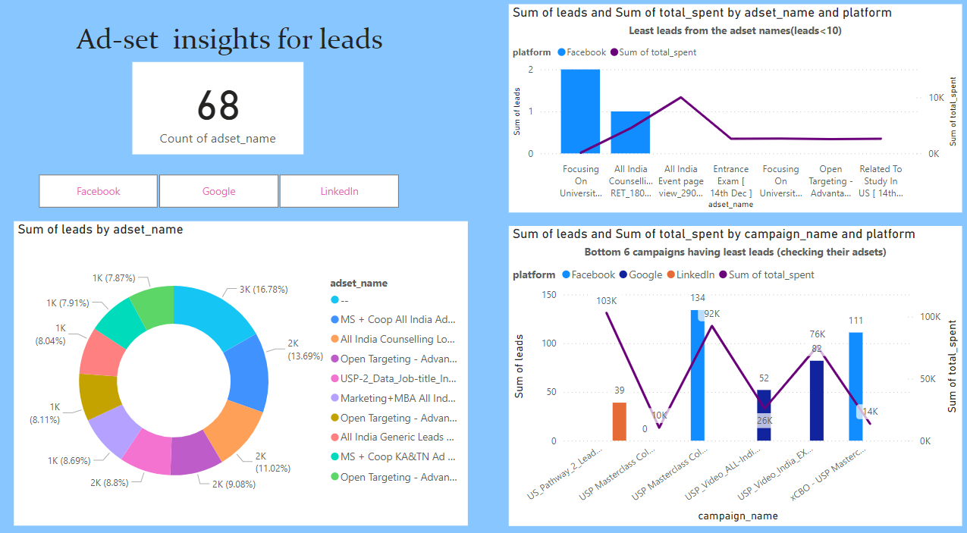
Ad-set Performance
01
02
03
04
05
06

Slide 10
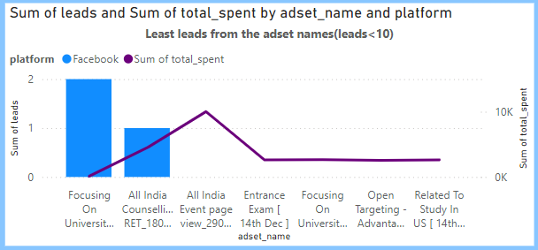
Least Ad-sets
Underperforming Ad Sets:
The line-bar plot at the ad set level reveals a striking insight: all the least-performing ad sets belong to Facebook. This is an outlier in the overall analysis, as Facebook typically drives strong results. The poor performance of these specific ad sets negatively impacts the overall campaign performance metrics. For the business, this indicates a critical need to investigate these ad sets—examining targeting, creative quality, and audience segmentation—to identify and address the root cause of their underperformance. This will help restore Facebook's effectiveness as a key platform.

Slide 11
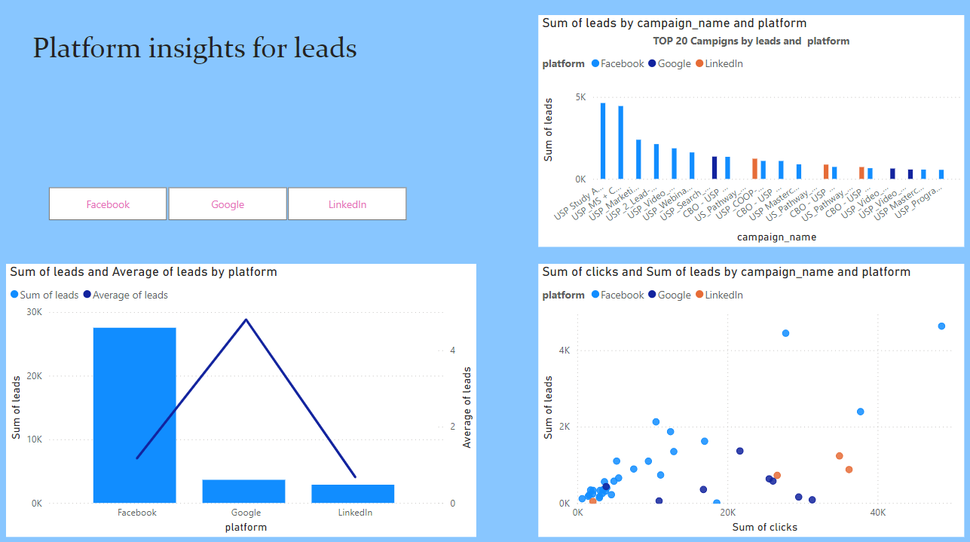
Platform
01
02
03
04
05
06

Slide 12
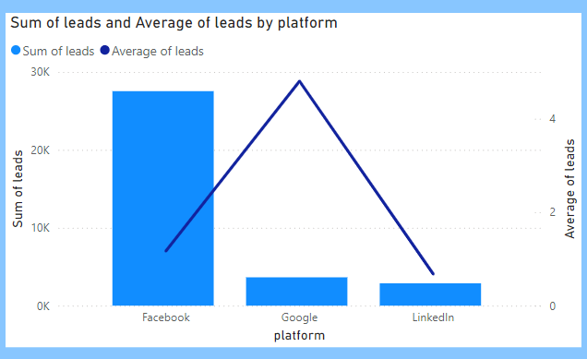
Sum & Avg leads by platform
Sum vs. Average Leads:
The bar-line chart reveals distinct patterns across platforms. Facebook generated the highest total leads (bar), driven by its 29 campaigns, indicating its scalability and reach. However, Google, with only 8 campaigns, shows the highest average leads per campaign (line), demonstrating its efficiency and potential for high-quality lead generation. LinkedIn, with 4 campaigns, contributes modestly to both metrics. For the business, this insight suggests leveraging Facebook for volume while focusing on optimizing Google campaigns for efficiency. LinkedIn could be explored further to understand its niche value in the strategy.

Slide 13
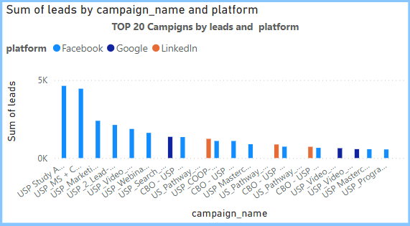
Best Campaigns(Platform)
Dominance of Facebook:
The bar chart showcasing the top 20 campaigns by leads highlights a clear dominance of Facebook, with the majority of campaigns originating from this platform. Additionally, 3 campaigns are from Google and 3 from LinkedIn, reflecting their comparatively smaller but noteworthy contributions. This emphasizes Facebook's effectiveness in driving high lead volumes while suggesting that Google and LinkedIn campaigns, though fewer, may serve as complementary channels to diversify lead generation strategies. For the business, this insight underscores the need to maintain a strong presence on Facebook while strategically leveraging Google and LinkedIn for specific audience segments.

Slide 14
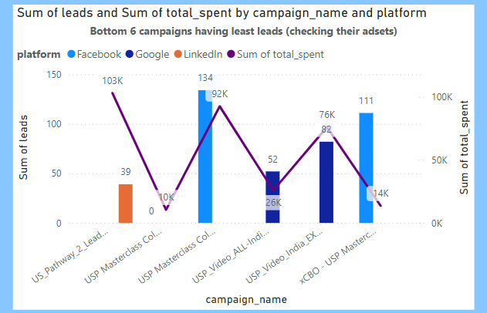
Why avg & Sum differ?
The difference between the average and sum of leads across platforms is largely driven by the number of campaigns and ad sets. Facebook, with its larger number of campaigns and ad sets, shows a higher sum of leads due to scale. However, its average leads per campaign or ad set can be lower because the platform includes a mix of both high and low-performing campaigns and ad sets, some of which underperform.
In contrast, platforms like Google and LinkedIn, with fewer campaigns and ad sets, show higher average leads. With fewer campaigns to consider, each one tends to be more optimized, leading to better results. This skewed average highlights the opportunity for businesses to focus on optimizing Facebook's underperforming campaigns and ad sets to improve both the average and sum of leads.

Slide 15
Clicks & Leads(Platform)
The scatter plot reveals distinct performance patterns across platforms. Facebook stands out with 3 to 4 campaigns showing high lead generation, indicating its potential for strong results but also highlighting the presence of variability in performance. Most Google campaigns are clustered around average lead generation, reflecting consistent but moderate performance. On LinkedIn, most campaigns are below average, suggesting that its current strategy or targeting may need optimization to drive better results. For the business, this insight points to the need to further capitalize on Facebook's high-performing campaigns, focus on optimizing Google for consistent lead quality, and reassess LinkedIn's targeting or creative strategies to improve its lead generation.

Slide 16





Conclusion
01
Dominance of Facebook:
There is a positive correlation between clicks and leads, showing that more clicks generally lead to more leads. Monthly performance analysis also revealed fluctuations, with certain months performing better, suggesting the importance of timing and seasonality in campaign strategies
02
Campaign Focus:
futurense
technologies
Facebook campaigns should be prioritized, scaling top performers while optimizing underperforming ones. Google campaigns, with consistent results, should be further optimized, and LinkedIn campaigns need a reassessment to improve lead generation.
03
Platform and Sum vs. Average Concept:
Facebook shows a high total lead count but a lower average due to the large number of campaigns, including underperformers. Google’s fewer campaigns generate higher average leads, while LinkedIn’s performance is below average. Focus should be on optimizing Facebook, scaling Google, and improving LinkedIn’s strategy.

Slide 17

Stratergies
Optimize Campaign Targeting and Creativity:
Refine Budget Allocation and Timing:
Leverage Data Insights Across Platforms:
Enhance targeting and improve ad creatives to increase click-through rates, as higher clicks correlate with more leads. Test different ad formats, visuals, and messaging to see what resonates best with your audience. A more engaging and relevant creative can significantly boost campaign performance.
Allocate budgets more effectively based on seasonal trends and the months that show higher lead generation. Use data insights to focus more resources on months or time periods where campaigns perform best. Additionally, experiment with bid strategies to ensure you're maximizing the efficiency of your spend.
Use the insights from high-performing campaigns on Facebook to guide improvements across all platforms. For Google, focus on optimizing keywords and bid strategies for consistent lead generation. For LinkedIn, reassess targeting criteria, test new ad formats, and optimize the creatives to better align with the audience’s preferences.

Slide 18

Thank You

